Slide 1
First, a brief tour of musical history.
In the early Middle Ages, all (known) music was monophonic, just single melodies with no other parts.
Kyrie V from the Liber Usualis, Anonymous Medieval plainchant.

Slide 2
Ca. 1200 composers start seriously working with polyphonic composition, developing the art of counterpoint.
Agincourt carol, early 15th century secular song.

Slide 3
The discipline of counterpoint often involves adding a line to something that already exists (the cantus firmus or “fixed voice.”)
cantus firmus

Slide 4
The discipline of counterpoint often involves adding a line to something that already exists (the cantus firmus or “fixed voice.”)

Slide 5
In doing this we don’t just get two lines. We also get a series of vertical intervals (or harmonies) that are constantly changing.
8
3
8
6
6
5
3
(here we get a nice mix of thirds, fifths, octaves, and sixths)

Slide 6
By combining more and more lines in counterpoint, composers gradually begin to discover triads.
Guillaume Dufay, Alma Redemptoris Mater II, early 15th century

Slide 7
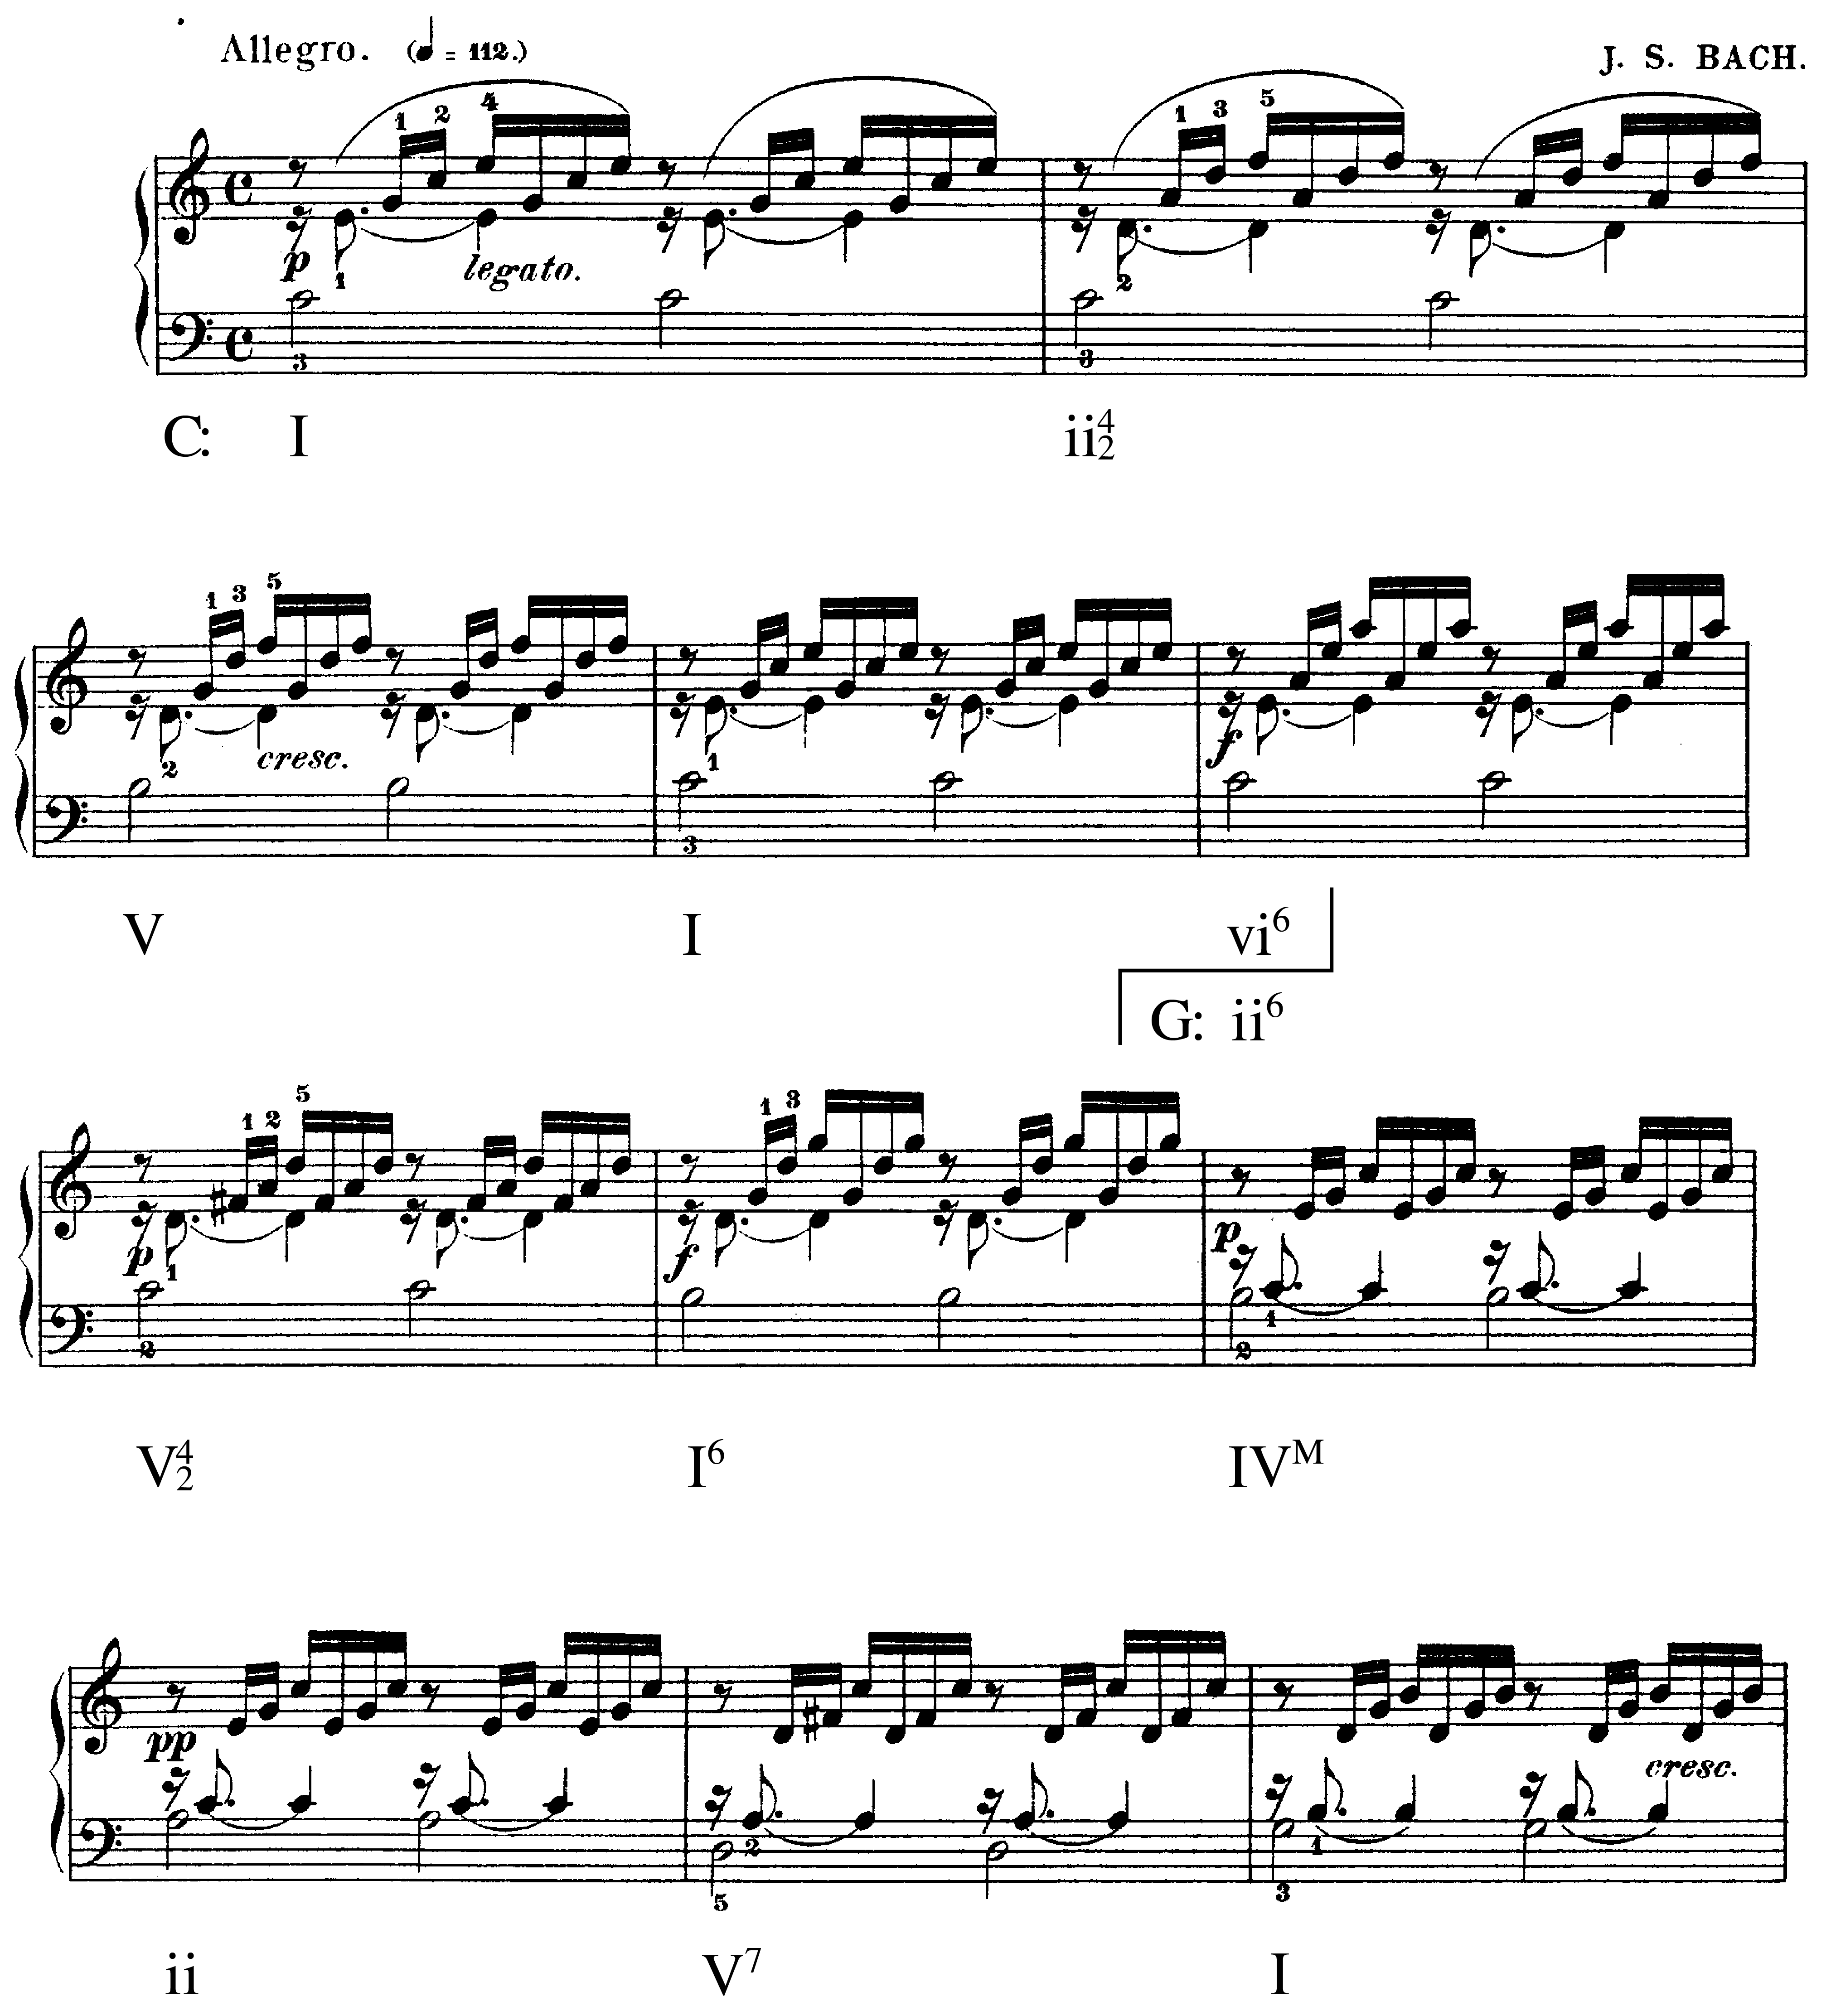
…and by the Baroque era [1600-1750], composers definitely know about chord progressions and think about them most of the time.
J. S. Bach, Prelude in C major from The Well-Tempered Clavier, Book I

Slide 8
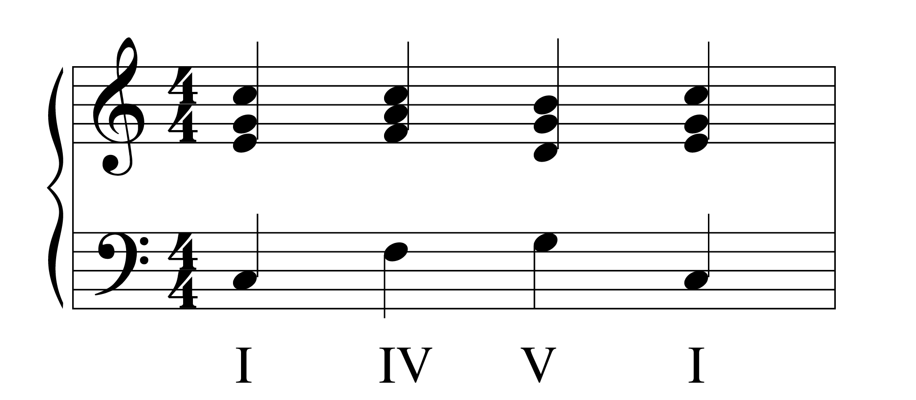
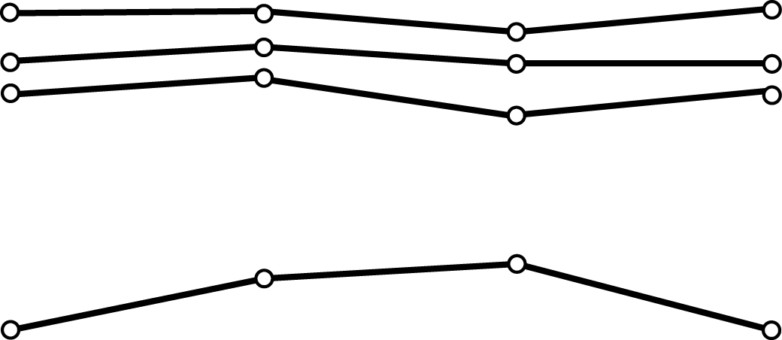
Throughout musical history, all the way to the 20th century, composers still want to have good counterpoint with their chord progressions.
You don’t have to do it all the time, but you should be able to when you want your music to sound polished and elegant.

Slide 9
Today we are going to get a taste of Renaissance-style counterpoint (= a super-conservative style.)
This is good music!
Josquin, Mille regretz, 15th century

Slide 10
We are going to create a “one-to-one” line against a part that already exists. This is called “first species” counterpoint.

Slide 11
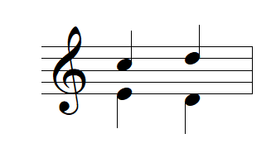
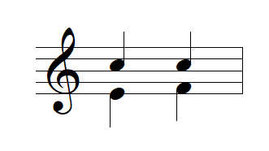
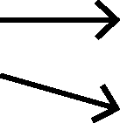
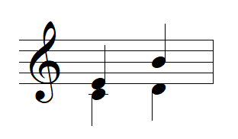
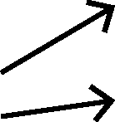
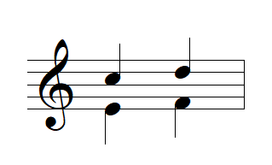
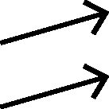
First, we have to define four kinds of motion.
Contrary Motion
Lines move in opposite directions.
Similar Motion
Moving in the same direction, but not the same distance
Oblique Motion
One line moves, the other one doesn’t.
Parallel Motion
The lines move the same distance in the same direction

Slide 12
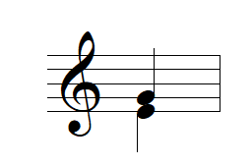
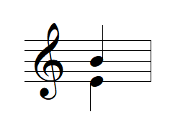
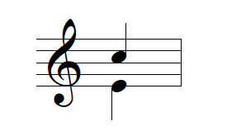
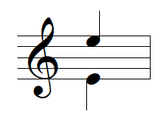
Rule 1: The Good Consonances
thirds
(perfect)
fifths
sixths
octave

Slide 13
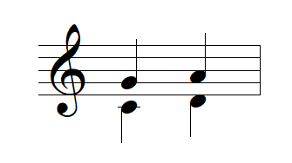
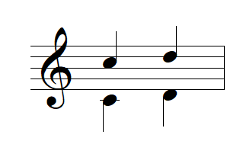
Rule 2: No Parallel Fifths or Octaves
If you are making a fifth, you may not proceed to another fifth.
If you are making an octave, you may not proceed to another octave.
BAD
BAD
parallel fifths
parallel octaves

Slide 14
WHY?
Fifths and octaves mimic intervals in the overtone series.

Slide 15
All naturally occurring pitches have this series of higher frequencies…

Slide 16
Spectral analysis of a clarinet tone. You can see the overtones!

Slide 17
The ear is constantly consolidating these frequencies into the perception of a single sound.

Slide 18
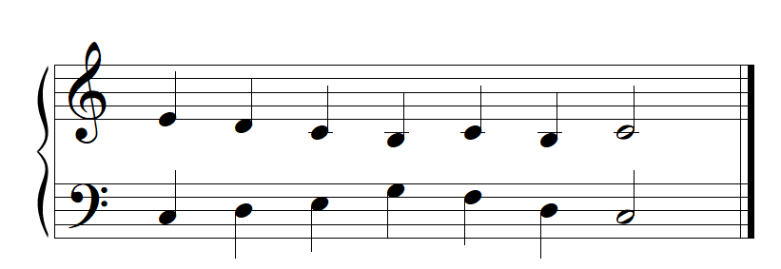
When the ear hears 5ths and 8ves moving in parallel it tries to fuse the sound together. This causes our counterpoint to collapse.
good counterpoint
parallel fifths at the end

Slide 19
So, Rule 2: No Parallel Fifths or Octaves
If you are making a fifth, you may not proceed to another fifth.
If you are making an octave, you may not proceed to another octave.
BAD
BAD
parallel fifths
parallel octaves

Slide 20
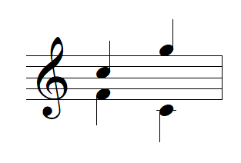
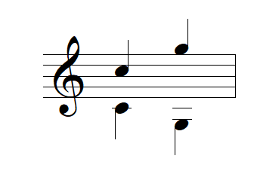
Rule 2b: No successive fifths or octaves by contrary motion
BAD
BAD

Slide 21
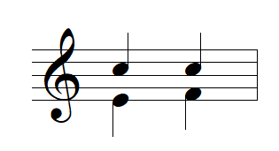
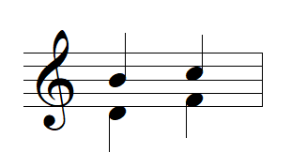
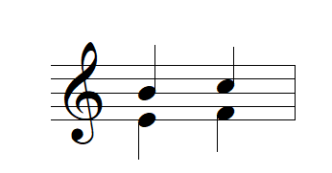
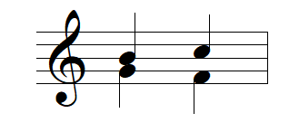
Rule 3: “Direct” 5ths and 8ves
You can only approach a fifth or octave by contrary or oblique motion. Doing it by similar motion makes a “direct” fifth/octave which pops out.
GOOD
GOOD
BAD
BAD
approaching by
contrary
approaching by
oblique
approaching by
similar motion is a “direct” fifth
we already know parallel firths are bad

Slide 22
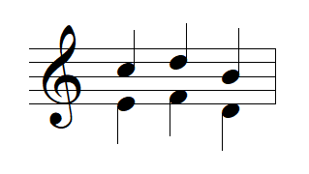
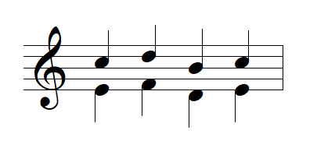
Rule 4: Limit on 3rds and 6ths
Parallel thirds and sixths are good. However, there is a limit of three 3rds or three 6ths in a row.
GOOD
TOO MANY WHAT ARE YOU THINKING

